Slide 1
Frame Allocation
Dept. of Information Technology,
Jadavpur University, Kolkata

Slide 2
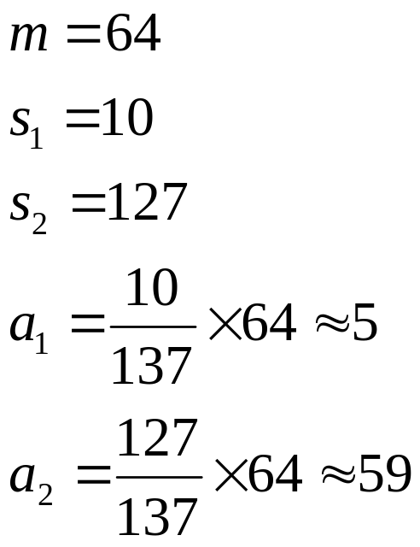
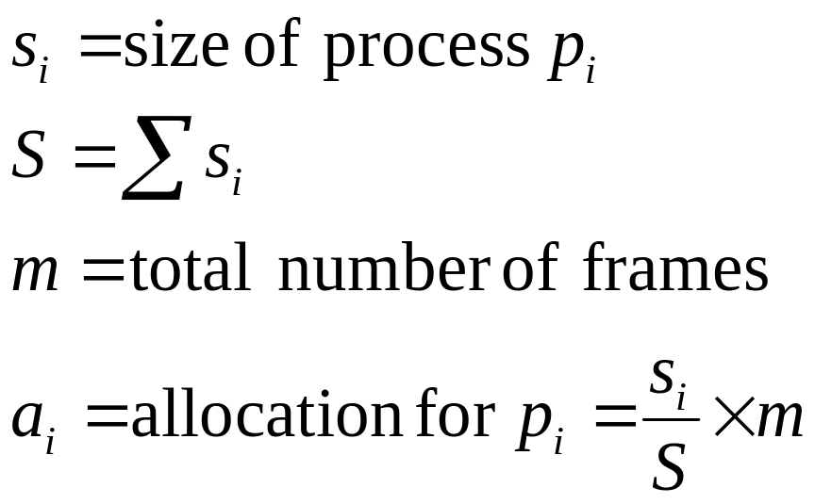
Allocation of Frames
Each process needs minimum number of pages
Two major allocation schemes
  fixed allocation
    e.g. Equal allocation – For example, if there are 100 frames and 5 processes, give 20 frames to each process.
  Proportional allocation – Allocate according to the size of process

Slide 3

Priority Allocation
Use a proportional allocation scheme using priorities rather than size
If process P_{i} generates a page fault,
  select for replacement one of its frames
  select for replacement a frame from a process with lower priority number

Slide 4
Global vs. Local Allocation
Global replacement – process selects a replacement frame from the set of all frames; one process can take a frame from another
  Process itself can not control its own page fault rate
Local replacement – each process selects from only its own set of allocated frames
  Less system throughput

Slide 5

Thrashing
Thrashing ≡ a process is busy swapping pages in and out
If a process does not have “enough” pages, the page-fault rate is very high. This leads to:
  low CPU utilization
  operating system thinks that it needs to increase the degree of multiprogramming
  another process added to the system

Slide 6

Thrashing
Demand Paging and Thrashing
Why does demand paging work?
Locality model
  Process migrates from one locality to another
  Localities may overlap
  Why does thrashing occur?
  Minimize Thrashing:
  Local replacement policy
  Provide as many frames as they require

Slide 7

Locality In A Memory-Reference Pattern

Slide 8

Working-Set Model
Δ ≡ working-set window size ≡ a fixed number of page references
Example: 10,000 instruction
WSS_{i} (Working Set Size of Process P_{i}) =
total number of pages referenced in the most recent Δ (varies in time)
D = Σ WSS_{i} ≡ total demand frames

Slide 9
Working-Set Model
m=total number of frames available
if D > m ⇒ Thrashing
Policy if D > m, then suspend one of the processes
If D < m, then more processes can be allowed
Selection of Δ
  if Δ too small will not encompass entire locality
  if Δ too large will encompass several localities
  if Δ = ∞ ⇒ will encompass entire program

Slide 10
Other Issues – Program Structure
Program structure
  int data[128][128];
  Each row is stored in one page
  Number of frames = 1
  Program 1
for (i = 0; i < 128; i++)
for (j = 0; j < 128; j++)
data[i,j] = 0;
  128 page faults
  Program 2
  for (j = 0; j <128; j++)
  for (i = 0; i < 128; i++)
  data[i,j] = 0;
  128 x 128 = 16,384 page faults

Slide 11

Page-Fault Frequency Scheme
Establish “acceptable” page-fault rate
  If rate too low, process gains frame
  If no free frame available, suspend one or more process
  If rate too high, process loses frame

Slide 12
Other Issues – Page Size
Page size selection must take into consideration:
  Fragmentation
  table size
  I/O overhead
  locality

Slide 13


